Slide 1
Agricultural Robots​
Zheng, Sharon

Slide 2
Overview
History​
History 2
Plan and Implementation
Plan and Implementation 2
Pros​
Cons​
Summary​
References​

Slide 3
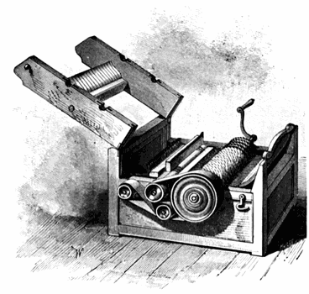
History
Also called an agribot or agbot
A revolution in agriculture occurred due to machines (1752-1900)
Robotics introduced in 1920
1974 - Eli Whitney’s cotton gin
1950s and 1960s - research of autonomous agricultural vehicles
Notes:
Cotton qin isolated cotton seed from cotton fiber
50 pound/day
Increases demand for slave labor
(picture above is his cotton gin)
In 1980 computers made the vehicle vision possible
Not perfect, needed cable systems

Slide 4
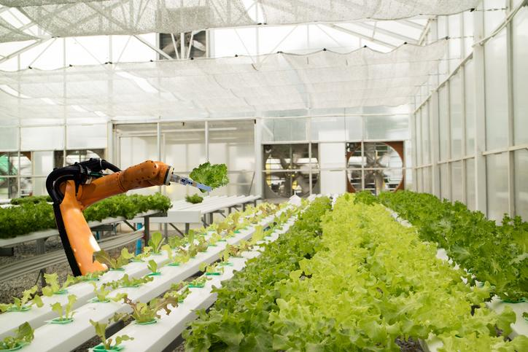
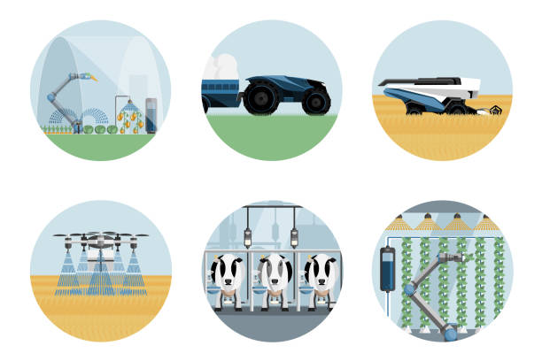
History 2
Machines have been used and improved for decades now
Harvesting and picking
Use for livestock
Seeding and planting
Sorting and packing
Notes:
Are the current agricultural robots we have today, use today mostly
Harvesting and picking is the most popular
Seeding and planting is emerging recently;
A lot of things have the line blurred between we already have it or it is close
Hard to tell, different websites give different results
Livestock: Milk cows, rear sheep, push feed, clean manure

Slide 5
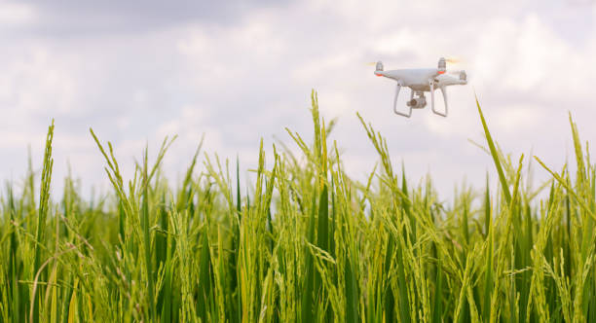
Plan and Implementation
Emerging applications are robots/drones for weed control
Fertilizing, irrigation
More appliances for precision agriculture
Notes:
Automation tech into bio-systems
Agriculture, forestry, greenhouse, horticulture, fisheries
Some people have weed control already?
Since it has been getting more attention in recent years, partly due to the over 9 billion population estimations of 2050.

Slide 6
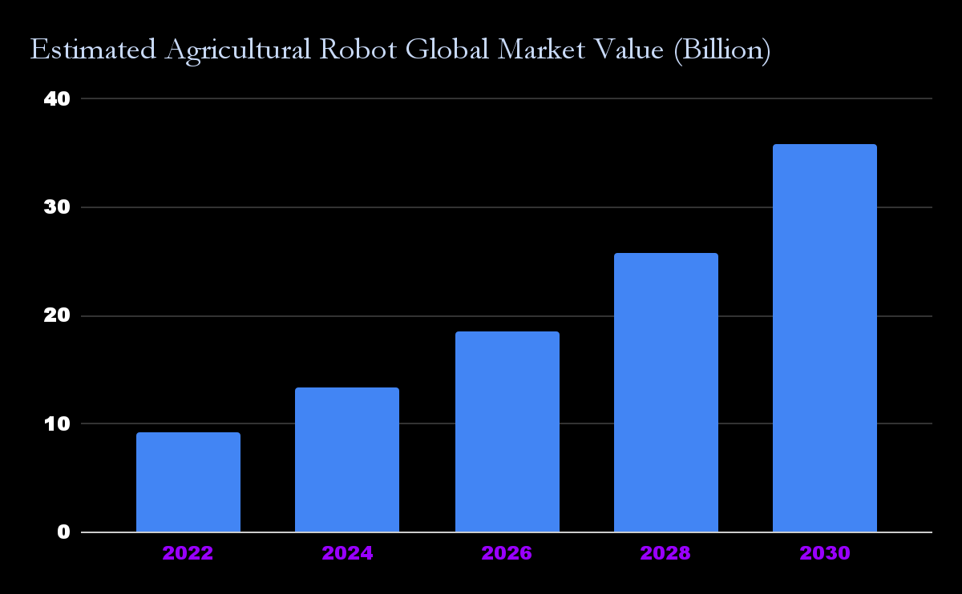
Plan and Implementation 2
Notes:
Estimated Increased an average of 40% every two years
This is due to the fact that it is drawing new professionals, companies and investors.

Slide 7
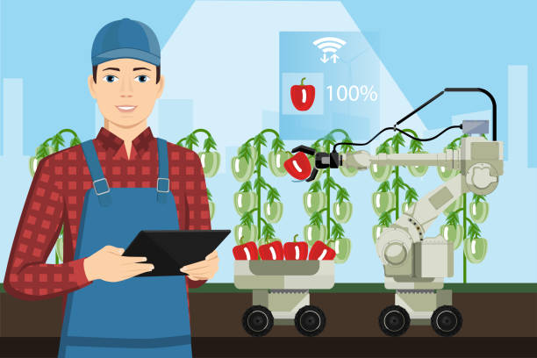
Pros
Do not get sick/ need time off
Fewer error, higher speeds
Higher quality products can be sensed more accurately
reduce use of pesticides
Creates a job
Can do things harmful to workers
Lowers cost of farming
Notes:
The job is both and bad thing, less original agricultural jobs, but the new ones are more technology focused
Lowers cost of farming itself, and probably food in the market.
Job: making and fixing the robots

Slide 8
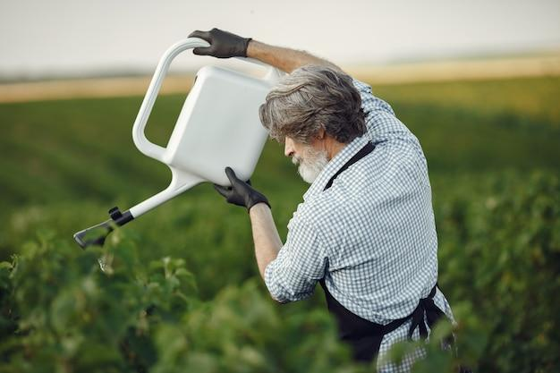
Cons
Pricing competitive,
Cost a lot of money to make/buy robots
Need maintenance
Some farmers lose jobs
Can change the emotional appear of agriculture
Energy issues costly
No real intelligence, which is needed sometimes
Notes:
Emotionally, the art of farming will not feel the same, like how some farms who are not mass producing things will take better care of their animals, yet due to a higher price, less people buy from them, and not many are willing to do so.
Hard on farmers who stick to it by hand and efforts and appreciation for farming will likely drop

Slide 9

Summary
Good and Bad
Job gets replaced with another
This market is predicted to go up by a lot, a good thing to some.
More food produced
Great considering amount of people predicted
Notes:
Old jobs get replaced by new ones, regarding the same field basically.
Do some research on jobs you may like, in a few years, it may be replaced
Currently used for many things, plans have been made to add to that list
They can be an advantageous and a disadvantage
Same idea as a lot of current jobs that is under pressure from developing technologies
Some people lose jobs, others gain, if the same amount of new jobs will be available as the old are losing debatable

Slide 10
References
Agrifarming
Eli Whitney Invents the Cotton Gin
Agricultural robots advantages, disadvantages
Agriculture robot types
Agricultural robots Market(Global)
Robots in the future of Farming
(Robot) Farming Photos

